Slide 1
Finding Duplicate Images with Python
A Python code for Identifying Duplicate Images in a Folder

Slide 2
LIBRARIES USED
1). OS (Operating System)
The Python os library contains helpful tools and functions for interacting with the underlying Operating System being used to execute the running Python code. It can be used to query information about the system environment – including operating system, disk space, memory information, and which path Python is being executed from.
2).PIL (Python Imaging Library)
The Python Imaging Library adds image processing capabilities to your Python interpreter. This library provides extensive file format support, an efficient internal representation, and fairly powerful image processing capabilities.The core image library is designed for fast access to data stored in a few basic pixel formats. It should provide a solid foundation for a general image processing tool.

Slide 3
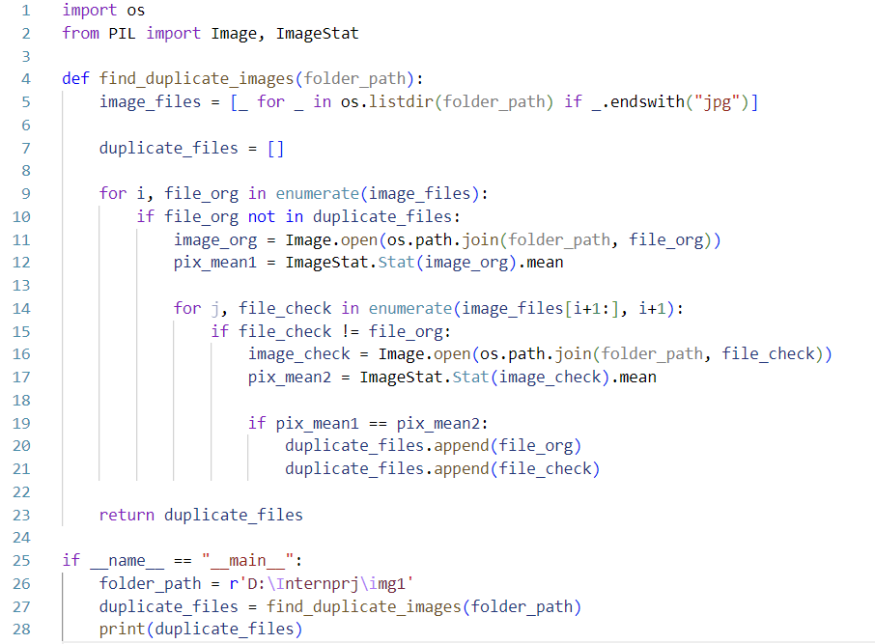
CODE SAMPLE

Slide 4
WORKING OF CODE
OS and PIL libraries are imported using the import statement.
A function called find_duplicate_images is defined that takes a folder_path parameter as input.
Inside the function, a list comprehension is used to create a list of all the image files in the specified folder that end with ".jpg". This list is stored in the image_files variable.
An empty list called duplicate_files is created to store the duplicate file names.
A for loop is used to iterate over each image file in the image_files list. The enumerate function is used to get the index (i) and the file name (file_org) of each file.
An if statement is used to check if the current file name (file_org) is not already in the duplicate_files list. If it is not, the script proceeds to check for duplicates.
The Image.open function is used to open the original image file (image_org) and the ImageStat.Stat function is used to get the mean pixel values of the image. This value is stored in the pix_mean1 variable.
Another for loop is used to compare the original image to all the other images in the image_files list, starting from the index immediately after the current image (i+1).

Slide 5
CONTINUATION OF WORKING
An if statement is used to check if the current image file (file_check) is not the same as the original image file (file_org).
The Image.open function is used to open the current image file (image_check) and the ImageStat.Stat function is used to get the mean pixel values of the image. This value is stored in the pix_mean2 variable.
An if statement is used to check if the mean pixel values of the original image and the current image are the same. If they are, the file names of both images are added to the duplicate_files list.
The function returns the duplicate_files list.
Finally, the if __name__ == "__main__": block is used to specify the folder path of the image files and call the find_duplicate_images function. The output of the function is printed to the console.

Slide 6
RESOURCES
Youtube
linuxscrew.com
pypi.org
python.org

Slide 7
CONCLUSION
This code finds all the image files in the specified folder that end with ".jpg" and compares each image file to all the other image files in the folder to find duplicates based on the mean pixel values of each image.
If two images have the same mean pixel values, they are flagged as duplicates and their file names are added to the duplicate_files list.
And original image , duplicate images file names will be printed as output.

Slide 8
THANK YOU

